Slide 1
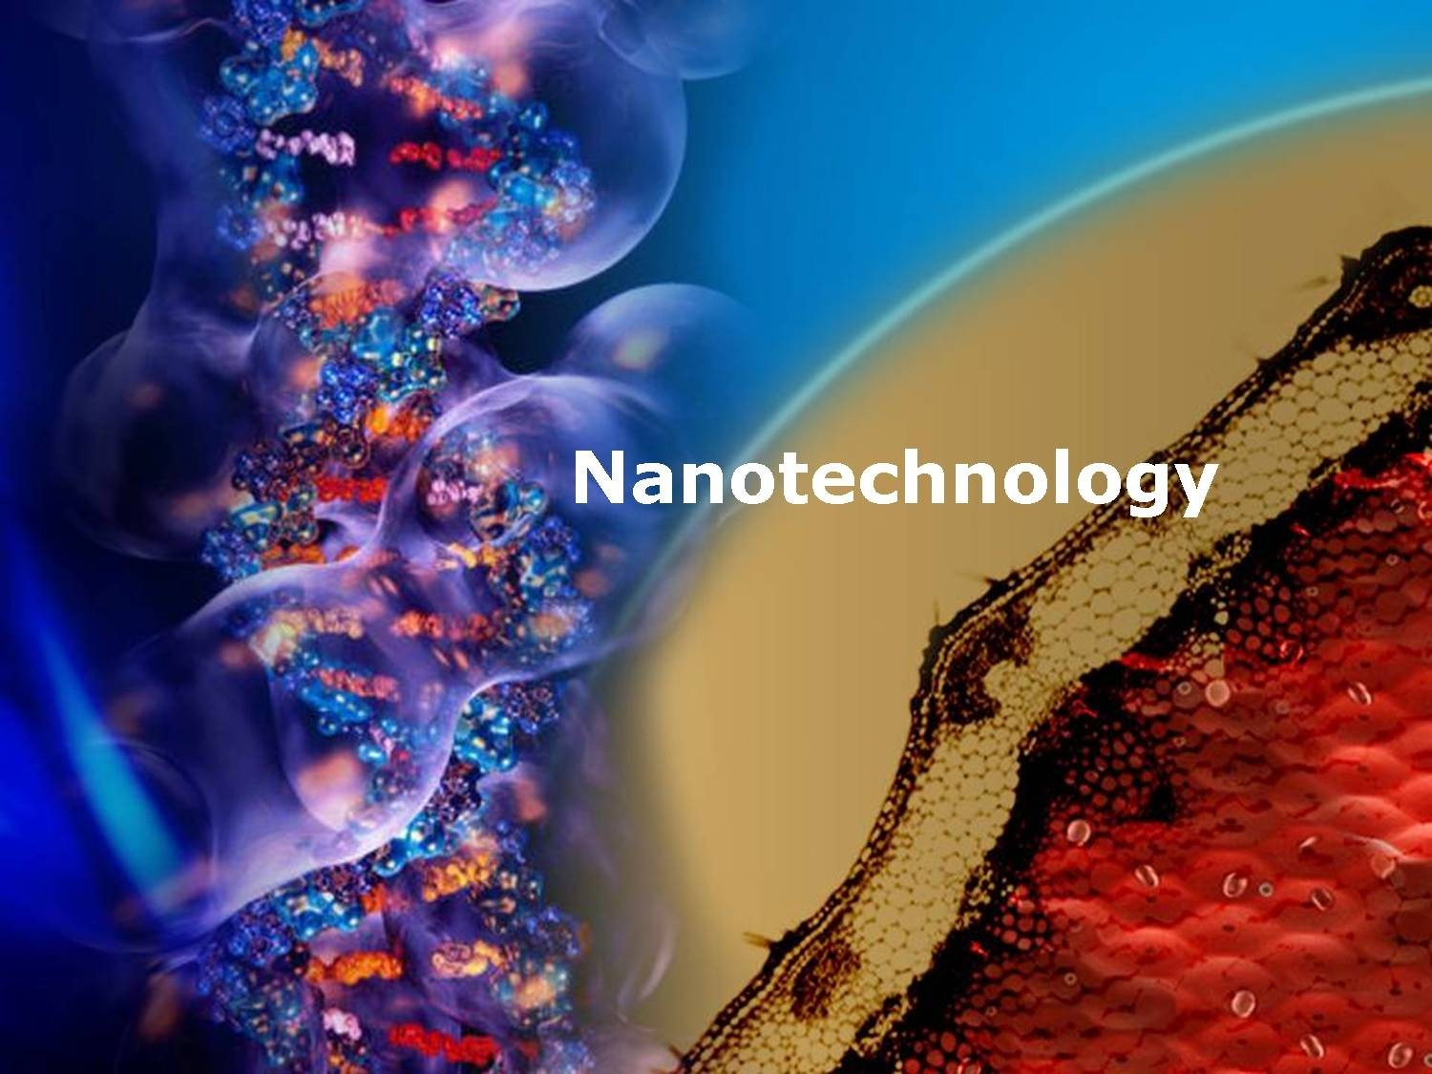

Slide 2
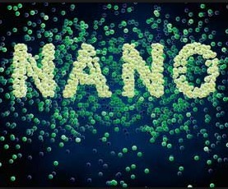

FUNDAMENTA L
Properties of substances dramatically changes when their size is
reduced to nanometer

Slide 3
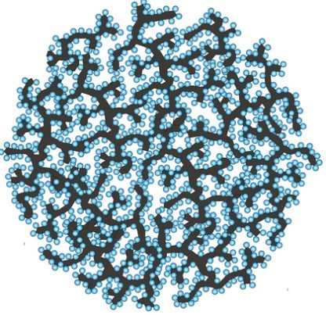
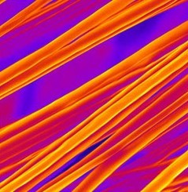

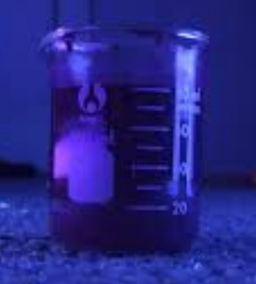
WHY NANO ?
NANO TECHNOLOGY IN TEXTILES?
NANO-FIBERS & YARNS
NANO-FINISHES

Slide 4
PRODUCTION TECHNIQUES
Cold plasma technology
Metal sputtering technology and metallic nanoparticles
Colloidal solutions
Sol-gel synthesis
Electrospinning

Slide 5
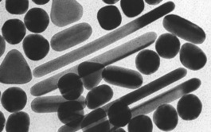
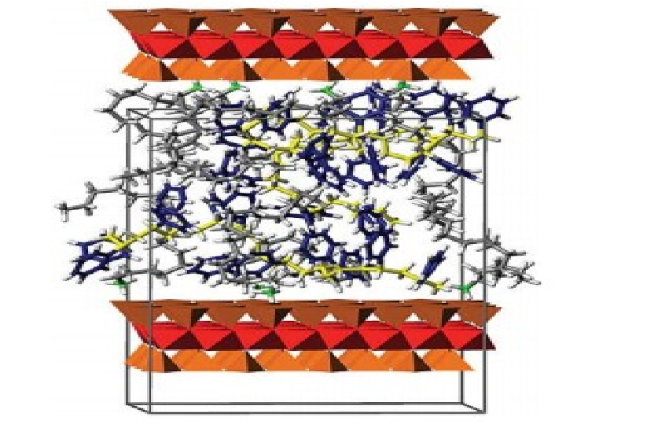
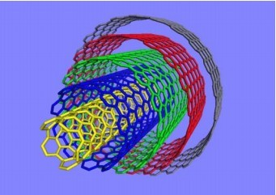
KEY NANOTECHNOLOGIES
NANOPARTICLES
NANOCOMPOSITES
NANOCAPSULES
NANOPOROUS MATERIALS
NANOFIBRES
CARBON NANOTUBES NANOCOATINGS

Slide 6
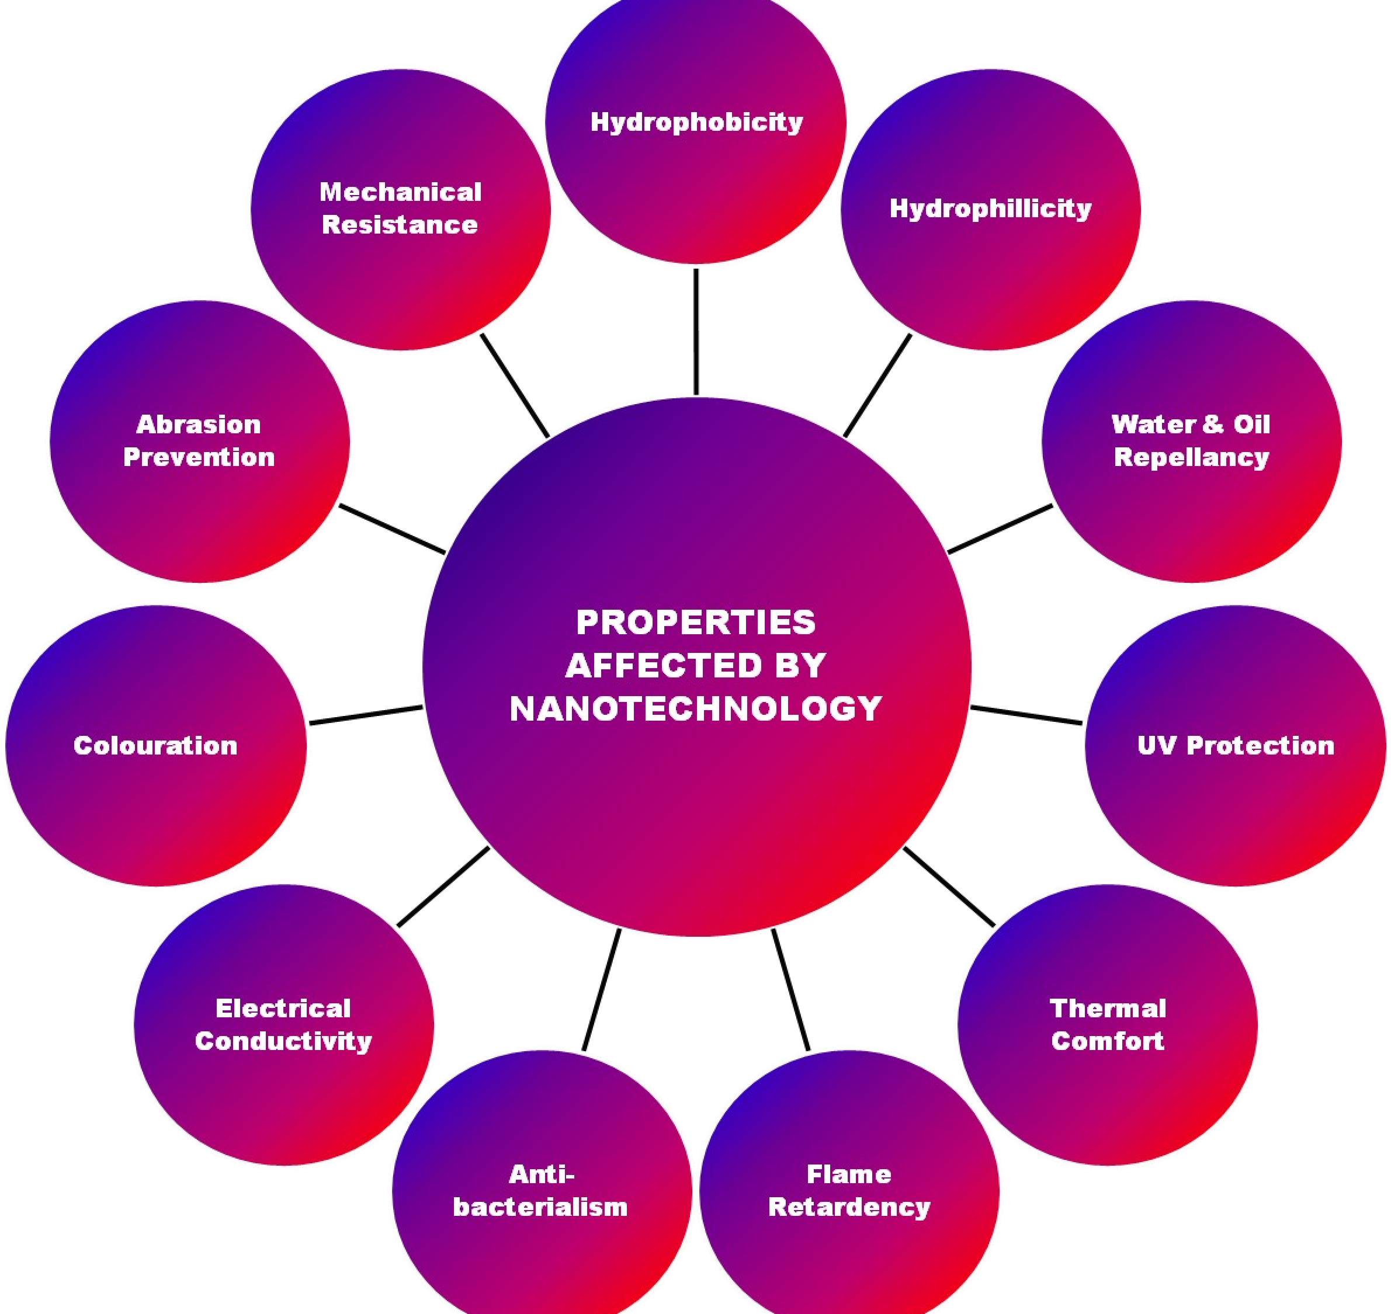

Slide 7
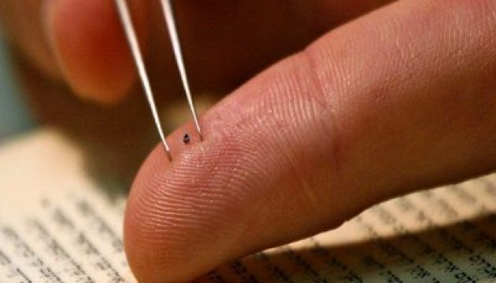
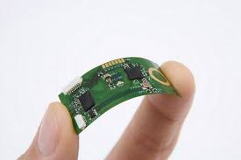

FUTURE APPLICATIONS:
NANO CARE
NANO PEL
NANO DRY
NANO TOUCH

Slide 8
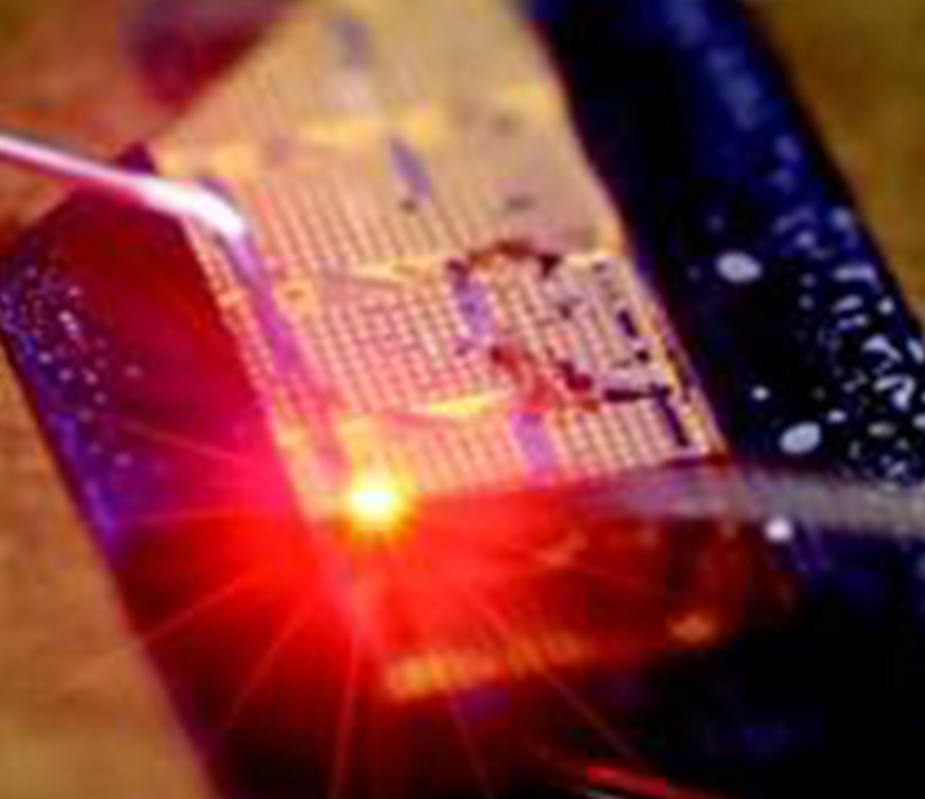
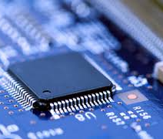
THANK YOU!!!

